Slide 1
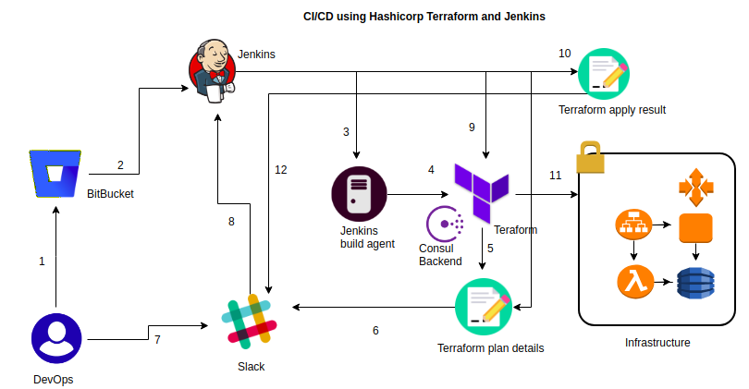
Jenkins Pipeline Creation Requirement

Slide 2
The developer or operations engineer changes the Terraform configuration file in his local machine and commits the code to Enterprise GitHub.
GitHub Webhook triggers a continuous integration job to Jenkins.
Jenkins will pull the latest code from the configured Repo which contains Terraform files to its Jenkins build agent workspace.
It reads the Terraform configuration then initializes the remote consul backend.
Terraform generates a plan about the changes that have to be applied on the infrastructure.
Jenkins will execute the terraform apply command to reflect the changes to the infrastructure.
Terraform will create a report about the resources and its dependency created while executing the plan.
Terraform will provision the resources in the provider environment.
Jenkins will again send a notification to the team email about the status of the infrastructure after the applying changes on it. Once the job is executed, Jenkins pipeline job is configured to clean up the agent workspace created by the job.
Jenkins: https://aws.amazon.com/blogs/opensource/continuous-integration-using-jenkins-and-hashicorp-terraform-on-amazon-eks/

